Slide 1
Terraforming azure
Ken Sykora

Slide 2
AGENDA
Problem Statement
A Simple Example
State
Which Tool and Why?
An Intermediate Example
Hybrid Cloud
An Advanced Example
ADO Pipelines

Slide 3

About Myself
Software Architect, focus on scalable cloud solutions
Software Development background (App Dev)
Dad
Gamer and Hobbyist
Wisconsin Sports Fan (don’t @ me)

Slide 4
Problem statement
Cloud configuration is complicated and nuanced.
Managing individual resources through a tool is not a scalable solution
Will inevitably leave discrepancies in resources that should be the same
challenging to review
Throws open the door for human error.

Slide 5
Infrastructure as code
Tools that enable “Infrastructure as Code” (IAC) promise to
Capture systems configuration in a centralized repository
Protect and correct configuration “drift”
Provide a means to review changes (via existing code review and CI/CD pipeline tools)
Provide a means to automate deployment of changes

Slide 6

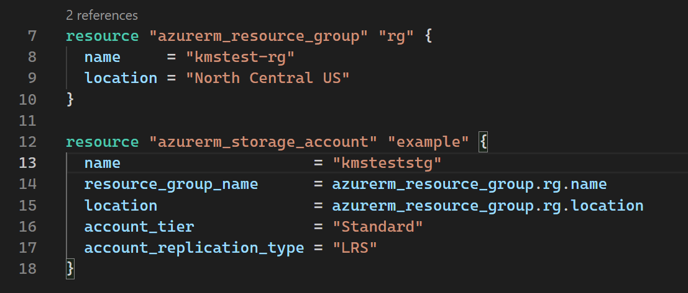
Terraform
Terraform is an open-source infrastructure as code software tool that provides a consistent CLI workflow to manage hundreds of cloud services. Terraform codifies cloud APIs into declarative configuration files.

Slide 7
Why Terraform?
 | Terraform | ARM | BICEP
Day 1 Support for Azure Resources | ❌ (4-8 weeks) | ✅ | ✅
Microsoft Support | ✅ | ✅ | ✅
Azure AD Resources | ✅ | ❌ | ❌
Multi Cloud & Hybrid Cloud | ✅ | (maybe with Azure ARC in the future?)
“The Delete Problem” | ✅ | ⚠ | ⚠
Battle Tested | ✅ | ✅ | ⚠
Folks, these are just my opinions. Please @ me

Slide 8
Less talk more (infrastructure as) code

Slide 9
THANK YOU
Ken Sykora
@kensykora
www.contoso.com

